Slide 1
Analysis of Drug Deaths: The Growing Opioid Crisis
Exploratory Data Analysis and Key Insights

Slide 2
Introduction to the Dataset
The 'Drug Deaths: A Story of Growing Opioid Abuse' dataset contains records of drug-related deaths, including demographic details, substances involved, and locations of death. Our goal is to uncover patterns and trends related to the opioid epidemic.

Slide 3
Objectives of the Analysis
1. Understand the demographic distribution of drug-related deaths.
2. Identify trends in opioid-related deaths over time.
3. Explore key risk factors such as age and location.
4. Provide insights to inform prevention and intervention strategies.

Slide 4
Dataset Overview
The dataset includes:
- Case numbers, dates, and manner of death.
- Demographics: age, sex, race, and location.
- Substances involved: opioids, benzodiazepines, etc.
- Over 32 columns detailing drug-related death information.

Slide 5
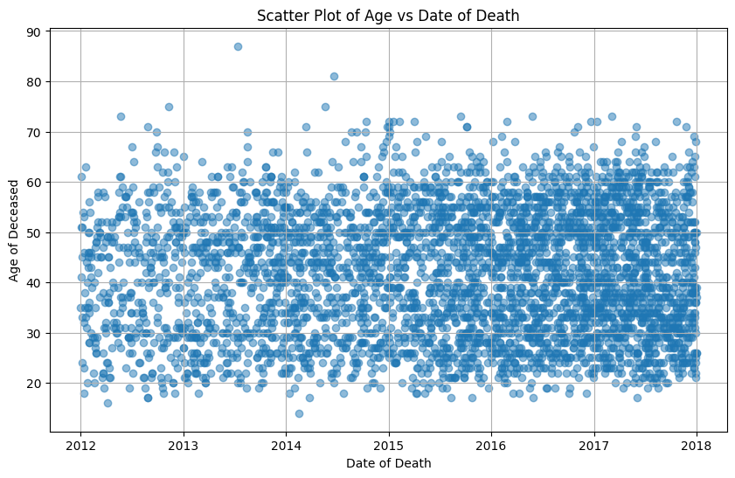
Scatter Plot of Age vs. Date of Death

Slide 6
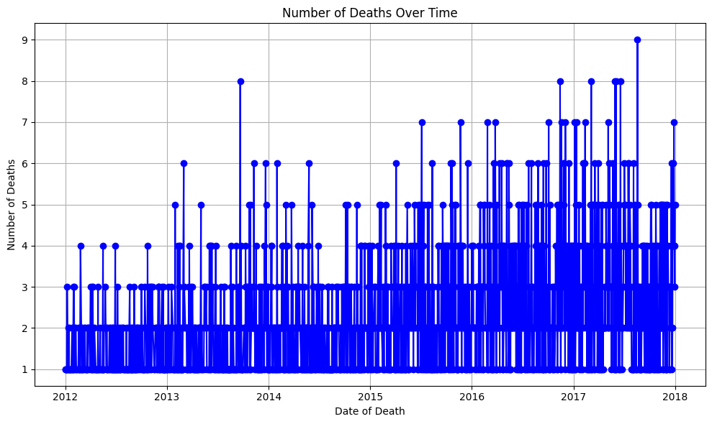
Age Distribution: Histogram

Slide 7
Key Findings
1. Drug-related deaths affect a wide range of ages, with certain age groups being more vulnerable.
2. The crisis persists over time, showing no specific time periods where the problem is isolated.
3. The wide distribution indicates the need for broad-based interventions targeting various demographics.

Slide 8
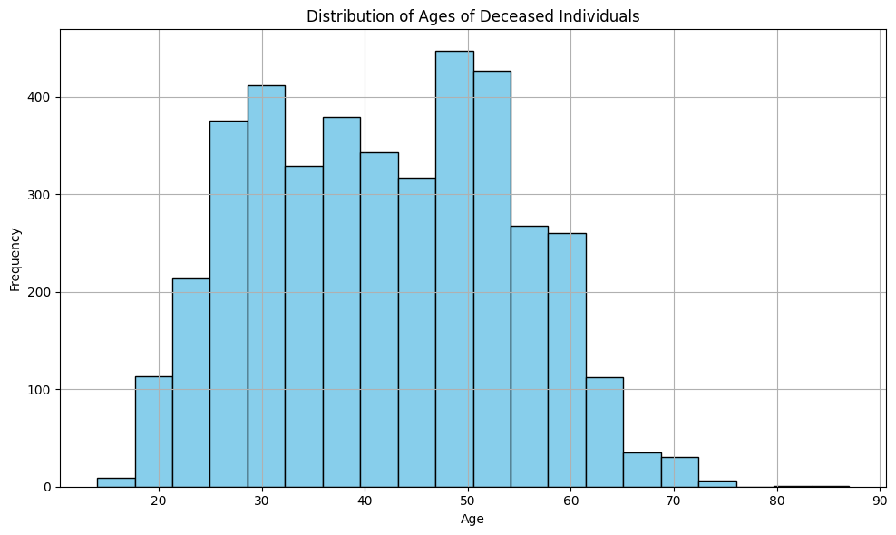
Number of Deaths Over Time: Line Chart

Slide 9
Recommendations
1. Focus interventions on the most vulnerable age groups.
2. Explore regional trends to direct localized responses.
3. Analyze specific substances involved in overdose deaths to shape targeted drug policies and treatment programs.

Slide 10
Conclusion
The opioid crisis affects all age groups and continues to be a persistent public health issue. Further analysis of specific substances and geographic regions can help inform more effective prevention and intervention strategies to address this ongoing problem.

